Slide 1
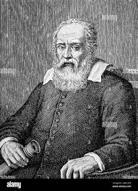
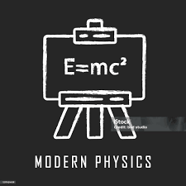
Welcome To The Modern Physics
THE PHOTOELECTRIC EFFECT

Slide 2
INTRODUCTION: In 1887, “Heinrich Hertz” observed the photoelectric effect in Germany, discovering that ultraviolet (UV) shining onto metal surfaces cause the ejection of electrons.
PHOTOELECTRIC EFFECT PHENOMENON:
When a light of certain frequency falls on a surface of a metallic plate it eject an electron from the surface of a metallic plate the ejected electron called “Photoelectron” and the current called “Photocurrent”. While the whole phenomenon is known as “Photoelectric effect”.

Slide 3
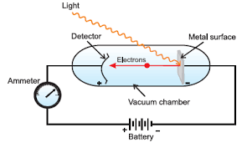
THE EXPERIMENT: WORKING & CONSTRUCTION: It consist of evacuated glass tube with two electrodes one is connected to positive and second is negative terminal of the battery.

Slide 4
RESULT OBSERVED:
There is no leg and gap between the striking of light beam and ejection of electrons from the metal surface.
The no. of electrons ejected is directly proportional to the intensity of that light.
For each metal there is a characteristics minimum frequency, which is also called “Threshold Frequency”, below which the photoelectric effect is not observed.
Kinetic Energy of the ejected (K.E) is directly proportional frequency of the striking light beam (µ).

Slide 5
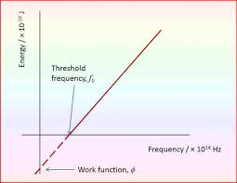
Work Function: Minimum energy required to remove an electron from metal surface is work function. Ǿ = hfo h Plank’s constant f Threshold frequency
Threshold Frequency:
Minimum frequency required which can cause photoelectric effect is called threshold frequency.
f < fo No photoelectric effect f > fo Possibilities f = fo Possibilities

Slide 6
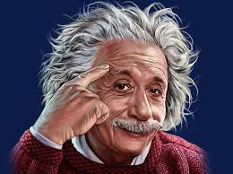
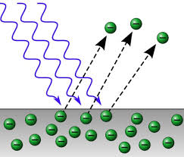
EXPLANATION OF PHGOTOELECTRIC EFFECT ON QUANTUM THEORY: EINSTEIN EXPERIMENT:
The History:
In year 1905, Albert Einstein also explained
this concept of photoelectric effect by using
“PLANK’S QUANTUM THEORY”.
Statement:
When a photon and a sufficient energy strikes an electron, a part of its energy which is called work function is used up in removing the electron from metal surface and removing the electron from metal surface and remaining energy appears as K.E of photoelectron.
Equations:
K.E_{max} = E - Ǿ
K.E_{max} = hf - hf_{o}
K.E_{max} = h (f – f_{o})
½ mv²_{max} = h (f – f_{o})
These are called “Einstein photoelectric effect”.

Slide 7
CHARACTERSTICS OF PHOTOELECTRIC EFFECET:
Threshold frequency is different for different material.
Photoelectric current is directly proportional to intensity of light.
The K.E of photoelectrons is directly proportional to frequency of light.
Stopping potential is directly proportional to frequency.
The process is instantaneous.

Slide 8
APPLICATIONS OF PHOTOELECTRIC EFFECET:
It can be used for automatic operations of switching of and off the street light.
It can be used in obtaining electrical energy from sunlight energy in solar cells and production of solar electricity.
They are used for producing sound in cinema film.
It can be used to study the temperature and spectra of stars.
uses in paper industries to measure the thickness of paper.
it can be used for automatic fire alarm.

Slide 9
CONCLUSION OF THE PHOTOELECTRIC EFFECT:
This photoelectric effect shows that light can act like tiny particle called Photons. It proved that only light with enough energy (high enough frequency) can knock out electrons from a metal surface. This couldn’t be explained by old science theories and helped start the new field of Quantum Physics. It also showed that light’s intensity effect the number of electrons, but there energy depends only on the light’s frequency. This discovery changed the way we understand light & energy.

Slide 10
THANK YOU

